Slide 1
Financing the Bio-economy: Key Factors Affecting the Role of Green Bonds and Financial Institutions
.
Don Roberts
CEO, Nawitka Capital Advisors Ltd.
Biofuture Summit II
Clean Energy Ministerial Biofuture Initiative
May 2021
..
Notes:
Hello – I am Don Roberts, the CEO of Nawitka Capital Advisors
This presentation focuses on key factors affecting the financing of the bio-economy.

Slide 2
THREE KEY QUESTIONS
With respect to the bio-economy:
Is the financial sector paying sufficient attention?
How can we reduce its complexity for investors?
Does it offer unique investment opportunities?
.
Notes:
Specifically, I focus on answering 3 questions.
With respect to the bio-economy:
Is the financial sector paying sufficient attention?
How can we reduce its complexity for investors?
Does it offer unique investment opportunities?

Slide 3
1. DOES THE BIO-ECONOMY GET ENOUGH ATTENTION?
Are the institutions which are involved in green and sustainable finance sufficiently considering bioenergy and bio-economy projects in their portfolios?
It depends.
In some cases the bio-economy offers unique opportunities to investors, and in others it does not. (We explore some of the unique opportunities later.)
Within the electricity sector, bio-power makes the most sense in the context of Combined Heat & Power (CHP) projects which have access to an abundance of low cost biomass. However, in most places stand-alone bio-power plants have a difficult time competing against other sources of green electrons (eg., solar, wind, hydro) – the fundamental business case is often weak. As a result, wood pellet plants targeting power generation may also be questionable long-term investments.
Biomass-based projects are often more complex than other “clean investments”.
Feedstock risk is unique to such projects, with a general lack of transparency in biomass markets. This is particularly relevant since the delivered cost of biomass is often over 40% of a plant’s variable cost.
It is important to distinguish between the physical and economic supply of biomass, and this requires good data and analysis.
How can we reduce the complexity of investments in biomass-based projects so financial institutions will be more engaged?
Notes:
Regarding the first question, - Does the Bio-economy get enough attention from the financial sector?
The answer is – it depends:
In some cases it offers unique investment opportunities, and in others it does not
For example, in the Electricity sector it does not. The business case for biopower is often weaker than that of other sources of green electrons.
Biomass-based projects are also often more complex – challenge for financiers.
…..This lead to the next question – how can we reduce the complexity for investors?

Slide 4
2. HOW CAN WE REDUCE THE COMPLEXITY FOR INVESTORS?
Credit Risk Rating Systems Move over $9.5 Trillion annually.
>2.8M ratings each year demonstrate the value of a standardized approach to evaluating biomass investment risk
Credit Ratings enable massive efficiencies for the capital markets. But we don’t have anything like this to facilitate biomass-based investment!
Application of a rules-based, standardized approach to quantifying risk is a proven way of reducing investors perceptions of risk.
Biomass Supply Credit Rating (BSCR) Standards create similar efficiencies by simplifying and de-risking investment into biofuel, biochemical and bio-material projects.
Notes:
Credit rating systems are well established for the overall economy.
>2.8 M ratings done annually
Move over $9.5 T in capital.
So the question is: “How can we extend the proven benefits of CREDIT RATING to the ‘BIOMASS sector?” Specifically, can we create Biomass Supply Credit Ratings?
If we can,, some of the potential benefits of biomass standards are:
reduced cost of funding,
access to a larger pool of investors
faster deployment of capital

Slide 5
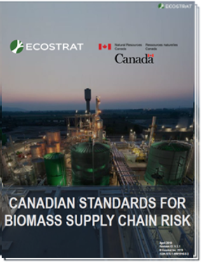
STANDARDIZED TOOLS FOR BIOMASS INVESTMENT LOOK LIKE THIS….
>$5MM funded by the federal governments of Canada and the U.S.A.
5 years of development by Ecostrat, Canmet, Los Alamos and Idaho National Labs, 150-member industry stakeholder group, and 60 member, $60+B capital market review committee, and 14 person Advisory Group (of which I am a member).
Accredited National Standard of Canada in Q1 2021 by CSA and SCC. ANSI accreditation in the US in 2021/2022.
Download at www.ecostrat.com/standards
“The Biomass Supply Chain Risk Standards are one of the great analytical frameworks that the bio-sector has seen. Before these criteria, there were no rating agency guidelines for how to measure the credibility of feedstock, so investors were left to guess. Now, there’s a quantitative model with qualitative aspects that has transformed bio, and the bioeconomy forever.”
John May, Managing Director Renewable Energy Investment, Hamilton Clark; formerly Co-Head of Stern Brothers & Co Investment Bank’s Renewable Energy Practice, Scaling Up Conference, Oct 2020.
(pioneer of the use of bonds for project finance debt in the renewables market with >$10 billion in loan and par values financed)
Notes:
So what do Standardized tools for biomass investment look like?
Gov’ts of Canada & U.S.A. have financially supported the development of Biomass Supply Credit Rating Standards.
>$5M in funding
5 years of development :
Led by Ecostrat, Canmet, Los Alamos & Idaho National Labs
Involved a ~150 member industry stakeholder group,
A 14 person Advisory Group, of which I am a member.

Slide 6
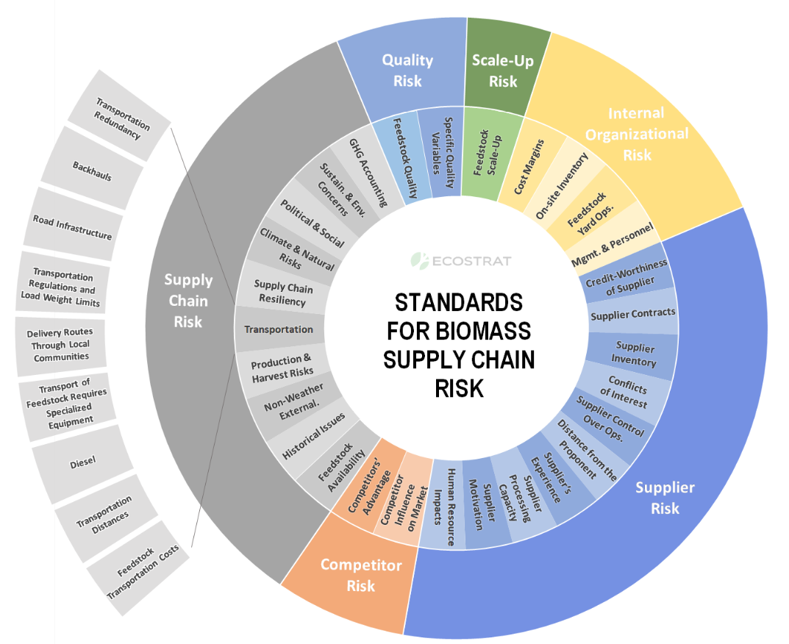
A STEP-CHANGE IN THE STATE OF THE SCIENCE FOR BIO-BASED INVESTORS
The BSCR Standards are the most rigorous framework devised to date for accurately rating feedstock risk for investors.
6 Categories, 28 Risk Factors, 126 Risk Indicators.
Reporting Requirements, Guidance & Best Practices.
Download the complete BSCR Standards:
www.ecostrat.com/standards
Notes:
THE BSCR Standard is the most rigorous framework devised to date for assessing feedstock risk for investors.
Involves 6 general risk categories, 28 risk factors & 126 specific risk indicators
Why is this needed?

Slide 7
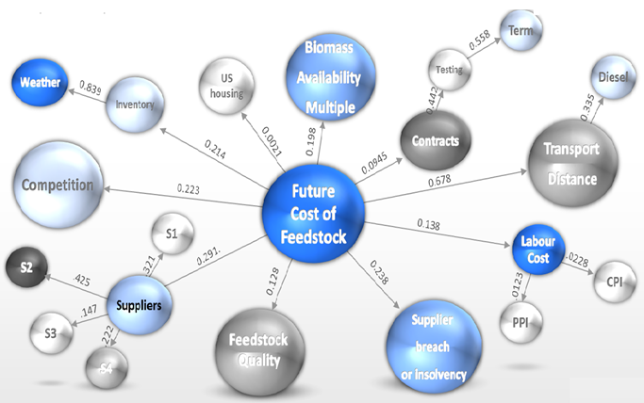
LACK OF STANDARDIZED INVESTOR TOOLS TO MEASURE BIOMASS FEEDSTOCK RISK IS A KEY INVESTMENT BARRIER
In order to finance bio-economy projects, lenders and equity participants are looking for credit worthy counterparts to provide long term feedstock security. But biomass suppliers are often small and almost never investment grade. Traditional balance sheet financing is challenging.
Biomass feedstock risk can be complex. Investors are often confused. Pools of deployable capital to bio-economy projects are limited. Sector investment is slow and expensive.
Efficient, low-cost capital requires new tools that help investors simplify decision-making and de-risk investment. The lack of these tools is a significant barrier to investment into sector development and has dampened the effectiveness of government policy in the sector.
The BSCR Standards enable capital to properly structure around feedstock risk and drive lower cost capital into the bio-economy
Notes:
Reality is that biomass supply chains are complex and investors are often confused.
The BSCR (or Biomass) standards are a blueprint for the capital markets to understand:
what these risks are
how to mitigate them; and,
how to properly structure capital around them.

Slide 8
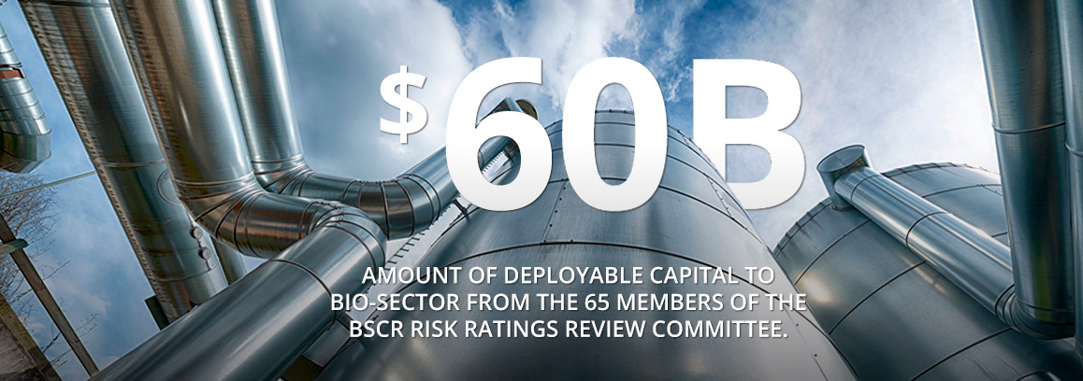
CAPITAL MARKETS SUPPORT THE DEVEOPMENT OF BIOMASS RISK RATINGS
The BSCR Risk Ratings Review Committee
Investors are looking for better tools to lower investment risk.
Key capital market players support a ratings system that signals low feedstock risk.
65 BSCR Review Committee members. >$60B of deployable capital
See all 65 members: ecostrat.com/standards/participants
Notes:
Participants across the financial spectrum and beyond are starting to applaud this innovation.
This tool could support a large and growing pool of capital that is looking to deploy across the bioeconomy.

Slide 9
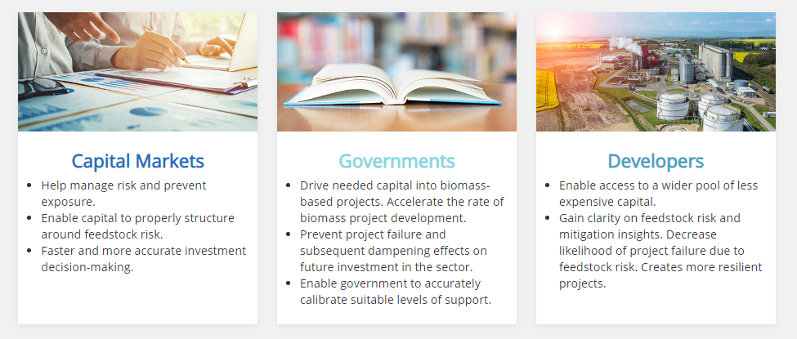
BENEFITS : BIOMASS SUPPLY CHAIN RISK STANDARDS AND RATINGS
BSCR Ratings remove a significant chunk of the perceived uncertainty out of investor lending decisions, and reduce time and transaction costs.
Provide greater confidence to lenders, and consequently broaden the range and lower the cost of financial resources available to biomass projects. As is the case for credit ratings, use BSCR rating can an effective negotiating tool for biomass project developers to access cheaper credit facilities.
Enable capital to roperly structure around feedstock risk; help avoid investment in projects that can fail; create projects that are more resilient.
Enable government to accurately calibrate suitable levels of support given project risk.
Notes:
The Standards provide benefits to Capital Markets, Governments & Project Developers.

Slide 10
THE NEED FOR BIOMASS SUPPLY RISK RATINGS IS INCREASING
Interest in the bio-economy is increasing because of the rising demand for decarbonization of the global economy.
In April 2021, the Glasgow Financial Alliance for Net Zero pledged themselves to the mission of reaching zero emissions by 2050.
It represents 160 financial firms with $70 trillion of assets
The following leading non-financial firms have also committed to net-zero emissions, all within specific timelines:
By 2030: Proctor & Gamble, Siemens, Ikea, Microsoft, Unilever
By 2040: General Motors, Mercedes-Benz, AT&T, Walmart, Pepsico, Amazon,
By 2050: Shell, BP, Ford, Michelin, Nestle, Danone, Nike
.
Notes:
Interest in the bio-economy is increasing because of the rising need to decarbonize the global economy.
In April 2021, the Glasgow Financial Alliance for Net Zero pledged themselves to the mission of reaching zero emissions by 2050.
It represents 160 financial firms with $70 trillion of assets
The following leading non-financial firms have also committed to net-zero emissions, all within specific timelines:

Slide 11
3. DOES THE BIO-ECONOMY OFFER UNIQUE INVESTMENT OPPORTUNITES?
Two pathways for investors to follow:
The transition to a circular bio-economy, with the substitution of low carbon bio-based products for high carbon intensity products; and,
The role of forests and land use in reducing emissions and increasing ‘removals’ of CO2 from the atmosphere – natural climate solutions.
Notes:
3. DOES THE BIO-ECONOMY OFFER UNIQUE INVESTMENT OPPORTUNITES?
Two pathways for investors to follow:
The transition to a circular bio-economy, with the substitution of low carbon bio-based products for high carbon intensity products; and,
The role of forests and land use in reducing emissions and increasing ‘removals’ of CO2 from the atmosphere – natural climate solutions.

Slide 12
CORPORATE TRANSFORMATION
Case Study: Shell
Expects to radically transform its product mix over the next 30 years. By 2050, Shell’s mix will be dominated by renewable power, biofuels and hydrogen, with all fossil-based carbon in its operations either captured and stored, offset in nature, or embedded in materials.
In February 2021, Shell’s Global CEO Ben van Beurden stated “I can imagine us capturing and storing maybe 50 million tonnes a year of carbon dioxide. I can imagine us working with nature to lock away maybe 300 million tonnes in forests, in wetlands and soils”.
Companies like Shell are looking to pursue both the pathways offered by the bio-economy – and at scale.
.
Notes:
To understand how some corporations are seeing the opportunities, consider Shell.
Over the next 30 years Shell expects to radically transform its product mix – shifting to lower carbon products
Also increased emphasis on capturing & storing carbon, with a special focus on Nature Based Solutions.
CEO quote in Feb: “I can imagine us working with nature to lock away maybe 300 million tonnes in forests, in wetlands and soils”
Companies like Shell are looking to pursue both the pathways offered by the bio-economy – and at scale.

Slide 13
THE ROLE OF BIOMASS IN A CIRCULAR ECONOMY
Demand for sustainable, re-usable, recyclable, and renewable materials is rising.
Toward a Circular Bioeconomy
By comparison the world produces 10b tonnes of concrete, 2b tonnes of steel and 400m tonnes of plastics each year.
How much of this could be substituted with biomass-based products which have lower carbon intensities?
A good deal, but it will depend critically on a meaningful price on carbon.
Notes:
This slide focuses on the first general pathway
The Bio-economy offers many opportunities to reduce the carbon intensity of products and contribute to a circular economy
Entails:
using many different sources of biomass –~ 25 B tonnes/year from agriculture/forestry/aquatic sectors
Producing wide range of products for the food/building/energy sectors
Note that to make this transition to a circular economy work financially, we will need a meaningful price on carbon.

Slide 14
POTENTIAL FOR NATURAL CLIMATE SOLUTIONS
Sustainable Forestry and Agriculture, conservation and restoration are now seen as central to climate change mitigation
Deforestation, degradation of ecosystems, and agriculture represent ~25% of global emissions
This represents ~10b tonnes of CO2 equivalent per annum—a large number.
Restoration and sustainable forestry and agriculture can also absorb CO2 in vegetation, soils and peatlands—goals of several billion tonnes per annum by mid-century
Notes:
Turning to the second general pathway.
Sustainable Forestry and Agriculture, conservation and restoration are now seen as central to climate change mitigation
Potential reduction of ~10 B tonnes of CO2e/year through a combination of:
Protecting intact lands
Managing working lands
Restoring natural ecosystems.

Slide 15
CHALLENGES FOR NATURAL CLIMATE SOLUTIONS
The demand for projects offering attractive nature-based climate solutions is arguably much greater than the supply of such projects.
The supply of suitable land that is available is a binding constraint, and getting nature-based climate solution projects at scale is a challenge.
Despite growing interest and support for nature-based solutions to mitigate climate change, few countries have developed the legal and regulatory frameworks needed to ensure fair and transparent transactions in carbon offsets trading.
These nature-based solution will largely be implemented in some of the poorest and most biodiverse regions of the world, and mostly on lands held by Indigenous Peoples and local communities.
Failure to adequately recognize community rights to carbon and their role in the realization of global climate ambitions poses a fundamental risk to the pursuit of nature-based solutions on the basis of equity, and in the context of sustainable development and poverty eradication as called for by the Paris Agreement
The BSCR Standard discussed earlier has a Social Risk factor in its Supply Chain Risk Category, but it arguably needs to be further refined to adequately reflect the above risks.
Organizations like The Nature Conservancy, Architecture for REDD+ Transactions (ART) and Rights & Resources Initiative are working to ensure that nature-based climate projects are appropriately implemented.
.
Notes:
What are the prospecting of implementing natural climate change solutions?
Demand for these kinds of projects is arguably much greater than the supply
Few countries have developed the legal and regulatory frameworks needed to ensure fair and transparent transactions in carbon offsets trading.
Furthermore, nature-based solutions likely to be concentrated in some of the poorest and most biodiverse regions of the world, and mostly on lands held by Indigenous Peoples and local communities
Failure to adequately recognize community rights to carbon poses a fundamental risk to the pursuit of nature-based solutions
Biomass Supply Credit Rating Standard discussed earlier has a Social Risk factor in its Supply Chain Risk Category, but it arguably needs to be further refined to adequately reflect the above risks.

Slide 16
THREE KEY CONCLUSIONS
It is not clear whether the financial sector is paying too little or too much attention to opportunities in the bio-economy.
It is clear that investment opportunities in the bio-economy are often quite complex to analyze, and this is a barrier to financing. One new tool to reduce the complexity is Biomass Supply Credit Rating (BSCR) Standards.
The bio-economy does offer unique investment opportunities. Nature-based climate solutions are one set of opportunities, and they are generating excitement among investors. However, the demand for such projects is likely to significantly exceed the supply.
.
Notes:
Not clear whether the financial sector is paying too little or too much attention to opportunities in the bio-economy.
Clear that investment opportunities in the bio-economy are often quite complex to analyze, and this is a barrier to financing. One new tool to reduce the complexity is Biomass Supply Credit Rating (BSCR) Standards.
The bio-economy does offer unique investment opportunities. Nature-based climate solutions are one set of opportunities, and they are generating excitement among investors. However, the demand for such projects is likely to significantly exceed the supply.

